Slide 1
Chapter 4: Patterns and Styles in
Software Architecture
Session I: Overview and History of Styles and Patterns

Slide 2
Session’s Agenda
Overview of Architecture Styles and Patterns
History of Architectural Styles and Patterns
  Origin of styles and patterns
Classification of Architectural Styles and Patterns
  Data-Centered
  Data flow
  Distributed
  Interactive
  Hierarchical
What’s next…

Slide 3
Overview of Architecture Styles and Patterns
In the previous module, it was established that software systems need to be carefully architected and evaluated from different perspectives.
  This is necessary to address multiple concerns that shape the quality of the system from different stakeholders with different backgrounds.
In this module, we pay special attention (mostly) to the logical view of software architecture.
  That is, the perspective that deals with decomposing the software system into logical components that represent the structural integrity that supports functional and non-functional (quality) requirements.
When designing logical architectures, it is important to use past experience to discover overall strategies that have been used successfully in the development of software systems.
  To this end, the concepts of architectural styles and architectural patterns have emerged as mainstream approach for achieving reuse at the architectural level.

Slide 4




Overview of Architecture Styles and Patterns
Architectural styles and architectural patterns provide generic, reusable solutions that can be easily understood.
  These can be easily applied to new problems requiring similar architectural features.
Decisions based on architectural styles and patterns benefit from years of documented experience that highlights
  The solution approach to a given problem.
  The benefits of these approaches.
  The consequences of employing these approaches.
Today’s Architects benefit from years of documented experience!
It is much harder for the Caveman to come up with the structural architecture of the house from scratch!
Build a house!
Build a house!
Important:
It is more efficient to build systems based on successfully employed designs than to come up with designs from scratch!
Today’s Architect!
Caveman!

Slide 5

Overview of Architecture Styles and Patterns
Similar to the previous example, today’s software architect can benefit from numerous documented styles and patterns for software architecture.
Once a pattern is identified, Architects can always refer to a pattern catalog to find documented details about it!
I need an interactive system, capable of displaying information from a data storage in multiple displays and different format!
Model-View-Controller Pattern
Model-View-Controller Pattern
View 1
View 2
Controller 1
Controller 2
Model
…
View 1
View 2
Model
Today’s Architect!
Customer specifies what he needs!
Software architected this way exhibit certain quality properties

Slide 6
History of Architecture Styles and Patterns
Before we move on, it is important to discuss the history of styles and patterns. This will help us eliminate some of the confusion between the terms styles and patterns.
In 1977, Christopher Alexander presented a language intended to help individuals, or teams, design quality structures of different sizes, shapes, and complexities [1]. According to Alexander et al.:
  “Each pattern describes a problem which occurs over and over again in our environment, and then describes the core of the solution to that problem, in such a way that you can use this solution a million times over, without ever doing it the same way twice.”
Alexander’s work resulted in a catalogue of 253 patterns, each describing in detail the essential information required for documenting the patterns, including [1]:
  Picture of the pattern
  Context of the pattern
  Problem that the pattern attempts to solve
  Evidence for its validity
  Related patterns

Slide 7
History of Architecture Styles and Patterns
Although Alexander’s work on patterns appears relevant to the software engineering profession, it actually referred to patterns found in the design of buildings and towns.
  This work, however, significantly impacted the field of software engineering.
In the 1990s, the software engineering community began researching and finding recurring high-level problem solutions in terms of specific elements and their relationships; these were originally referred to as architectural styles [2].
  Similar to Alexander’s work, Architectural Styles provided the means for software architects to reuse design solutions in different projects; that is, to use a “solution a million times over, without ever doing it the same way twice.”[1]
In 1994, Gamma, Helm, Johnson, and Vlissides—better known as the Gang of Four (GoF)—published their influential work that focused on a finer-grained set of object-oriented detailed design solutions that could be used in different problems “a million times over, without ever doing it the same way twice.”
  Influenced by Alexander’s work, they called these Design Patterns.
  Their work resulted in the creation of a catalogue of 23 (detailed design) patterns.
  Each pattern was described in detail, using a specific pattern specification format.

Slide 8
History of Architecture Styles and Patterns
In 1996, the work of Buschmann, Meunier, Rohnert, Sommerland, and Stal [3], integrated the work of architectural styles and design patterns by providing a set of well-known architectural styles using a pattern-like approach [2].
  They referred to these as Architectural Patterns.
In their work, Buschmann et al. provided their views about architectural patterns vs. design patterns[3]:
  “Architectural patterns … specify the system-wide structural properties of an application. They specify the system-wide structural properties of an application, and have an impact on the architecture of its subsystems.”
  “Design patterns are medium-scale patterns.”
  “The application of a design pattern has no effect on the fundamental structure of a software system, but may have a strong influence on the architecture of a subsystem.”
Hopefully, this helps clear the air between the concepts of architectural patterns vs. design patterns, but what about Architectural Styles vs. Architectural Patterns?
  There are documented differences between architectural styles and patterns!
  However, perhaps Buschmann et al. [3] put it best by stating that “Architectural styles are very similar to our architectural patterns. In fact every architectural style can be described as an architectural pattern.”

Slide 9

History of Architecture Styles and Patterns
Software Engineer
Is it a style or a pattern?
Many other work published on architectural styles, architectural patterns, and design patterns
Dwayne E. Perry and Alexander L. Wolf published the notion of Architectural Style for software systems
1977
1992
1994
1996
Is a style!
Is a pattern!
2012
The concept of Pattern is introduced for the design of Buildings and Towns
by Christopher Alexander
Gang of Four publishes influential book on Design Patterns
Buschmann et al. publishes book that “merges” the work on styles and patterns
Can’t we all just get along?

Slide 10
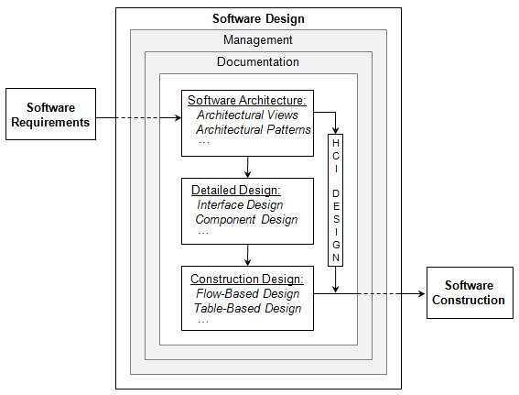
History of Architecture Styles and Patterns
Today, the terms architectural styles and architectural patterns are used to convey fundamental structural and architectural organization for software systems.
  Throughout the rest of the course, these terms are used interchangeably to denote reusable design solutions that occur during the software architecture activity of the design process.
  The term Design Patterns, as seen later on in the course, is used to denote reusable design solutions that occur during the detailed design activity of the design process.
Architectural styles and architectural patterns do not describe the detailed design of systems
  They are used as basis for system decomposition and for analyzing the structure of systems in principled manner.
Architectural Styles and Patterns exist here!
Software design model presented in Chapter 1
Design Patterns exist here!

Slide 11
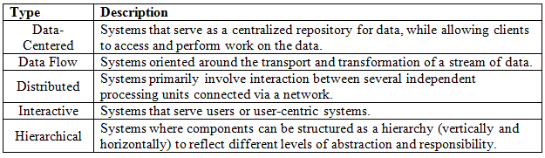
Architectural Pattern Classification
The choice of applying architectural patterns depend on the type of system, requirements, and desired quality attributes.
  These characteristics help guide the choice of selecting one particular pattern over another.
In some cases, more than one architectural pattern can be used in combination to collectively provide the appropriate architectural solution.
Architectural patterns can be classified depending on the type of system as shown below:

Slide 12
What’s Next…
In this session, we presented fundamentals concepts of architectural styles and patterns, including:
  Overview of Architectural Styles and Patterns
  History of Architectural Styles and Patterns
    Origin of styles and patterns
  Classification of styles and patterns
  Types of systems for classifying styles and patterns:
    Data-Centered
    Data flow
    Interactive
    Hierarchical
In the next session, we will discuss two types of systems: Data-centered and Data Flow, together with essential architectural patterns for these systems, including:
  Blackboard
  Pipes-and-Filters

Slide 13
References
[1] Alexander, Christopher, Sara Ishikawa, Murray Silverstein, Max Jacobson, Ingrid Fiksdahl-King, and Shlomo Angel. A Pattern Language: Towns, Buildings, Construction. New York: Oxford University Press, 1977.
[2] Clements, Paul, Rick Kazman, and Mark Klein. Evaluating Software Architectures. Santa Clara, CA: Addison Wesley, 2001.

